Slide 1
DSIK & ECPCGC
Virtual Training XX.XX.XXXX

Slide 2
Agenda
Intro
Customer Journey guides through Training
Modules 1-6
Closing

Slide 3
Introduction round
Quick roundabout introduction of yourself – after you finished → name someone who will follow up

Slide 4


Introduction round
Open your „Participants_Excel“ sheet you got with the invitation on the training
Open the Tab „Intro round“ on the bottom of the sheet
You will have 10 Minutes in a seperate breakout room with 3-4 people
Note the Similarities and Differences you find with your training colleagues
Group work:

Slide 5
MSME Training
Customer Journey
Presales
Client Meeting
P&L and BS
Assessment & Application
Approval
& Disbursement
Aftersales
Modules for the next 6 training days

Slide 6
ECPCGC Training
Presales
Client Meeting
P&L and Balance Sheet
Preparation for Client Meeting
Research
Information gathering
Customer relationship management
Interviewing methods
Understanding, calculating and interpreting selected financial metrics
Cash-Flow analysis
Skills & Knowledge
Training-Content
Customer Journey as orientation for
Training modules

Slide 7
ECPCGC Training
Approval & Disbursement
Aftersales
Justify credit decision
Monitor loan usage
Assessment & Application
Pricing
ECPCGC
Compiling and verifying data
Financial monitoring
Referral business
Long term relationship building
Dealing with loan rejection
Recovery
Training-Content
Customer Journey as orientation for
Training modules

Slide 8
ECPCGC Training
Time schedule

Slide 9
ECPCGC Training
Where are we today ?
ECCU economies dependent on import
Challenges & Opportunities in MSME Business
Huge potential for local economy to grow !!
Sources: EECB Trade Report

Slide 10
ECPCGC Training
MSME lending: Client expectation
Think as a client
Fast decision
Minimum documents
Less collateral
Proactive approach
Challenges & Opportunities in MSME Business

Slide 11

Challenges surrounding MSME lending
For financial institutions | For MSMEs
Low formality of customers | Low formality -> Low access to finance
Clients documentation is lacking or insufficient | High collateral requirements (up to 160%)
Absence of historical records | Inadequate infrastructure
Problems to track sources of information | High interest rates
High NPL Ratios | Decisions take a lot of times

Slide 12



Challenges surrounding MSME lending
An estimate of 60% of the worlds population participates in the informal sector
Shift from informal to formal benefits everyone (Countries, Share-/Stakeholders, Employees, collaborating business partner)
MSME
Age & Growth
Formality
Professionalism
Need for assistance

Slide 13

Group Work 15 Minutes:
Discuss within your groups the benefits for MSMEs to get registered and
how you would argue that to a client
Gather your ideas and arguements in the group excel
Presentation to the group afterwards

Slide 14
DSIK & ECPCGC
Virtual Training
Module 1
Presales
XX.XX.XXXX

Slide 15
Module 1
Presales
  Preparation for Client Meeting
  Research
  Skills & Knowledge
Presales
What do we know about our (new) customer?
Information can reach from simple to complex
For example: Gender (simple)
Scientific long-term studies show:
Women are less likely than men to purchase their business
Female owners are more likely to prefer low risk/return businesses
Women-owned firms generate higher revenue than male-owned firms
Male entrepreneurs are clearly more confident about the success of their business than their female counterparts
Sources: intotheminds.com
entrepreneurship.extension.org

Slide 16
Module 1
Presales
  Preparation for Client Meeting
  Research
  Skills & Knowledge
Presales
What do we know about our (new) customer?
Information can reach from simple to complex
For example: Business model (complex)
Might look easy at first glance but…
Innovative and disruptive Models
Niche Models
Wide business partner networks
Synergies in sourcing, selling or manufacturing
…always need deeper explanation

Slide 17
Lean Canvas
Lean Canvas is an easy way to explain a business model in 1 Page
There are variations of the Lean Canvas, such as the Business Model Canvas. The key idea stays the same
Problem
What are the 3 most important characteristics
of your issue?
Solution
3 important characteristics of your solution
Unique value proposition
Single, clear, compelling message that sates why you are different and worth paying attention.
Unique Selling Proposition
Differentiation to your competitors?
Customer Segments
List your target customers and target users
Key Metrics
… which you can measure and improve.
Channels
List your path to customers (inbound or outbound)
Cost Structure
List your fixed and variable coast.
Revenue streams
List your sources of revenue.

Slide 18
Lean Canvas
Problem
What are the 3 most important characteristics
of your issue?
1. Problem
Each customer segment (CS) you are thinking to work with will have a set of problems that they need solving. In this box try listing the one to three high priority problems that you customers have.
Without a problem to solve, you don’t have a product/service to offer.

Slide 19
Lean Canvas
Customer Segments
List your target customers and target users
2. Customer Segments
The problem and Customer Segments can be viewed as intrinsically connected — without a CS in mind you can’t think of their problems, and visa-versa.
“For whom are you creating value ?”

Slide 20
Lean Canvas
Solution
3 important characteristics of your solution
3. Solution
Finding a solution to the problem is the key! Not finding the best solution from the start is OK, as that’s what Lean is all about.
A way to validate your approach is to go out and interview your customer segment, ask them questions, and take those learnings.

Slide 21
Lean Canvas
Unique Selling Proposition
Differentiation to your competitors?
4. Unique Selling Proposition / Unfair Advantage
This is the most difficult to block to answer. Some call it your “unfair advantage”.
USP can be insider information, a dream team, getting expert endorsements, existing customers etc. Think about what you have no one else can buy.
“What differs you from your competitors ?”

Slide 22
Lean Canvas
Unique value proposition
Single, clear, compelling message that sates why you are different and worth paying attention.
5. Unique Value Proposition
In the center of the canvas is the UVP. A value proposition is a promise of value to be delivered. It’s the primary reason a prospect should buy from you. A way to figure it out is to think why are you different and why should your customer buy/invest time in you
“Which customer needs are you satisfying?”

Slide 23
Lean Canvas
6. Channels
Channels are ways for you to reach your customer. And remember that in the initial stages it’s important not to think about scale but to focus on learning. With that in mind try to think which channels will give you enough access to your customers and at the same time give you enough learning possibilities. Be where your customers are!
“How do you reach your customers?”
Channels
List your path to customers (inbound or outbound)

Slide 24
Lean Canvas
7. Cost Structure
Here you should list all the operational costs for taking this business to market. How much will it cost to build / landing page? What is your burn rate — your total monthly running costs? How much will it cost to interview your customer segment? How much do market research papers cost? etc. You can then use these costs and potential revenue streams to calculate a rough break-even point.
“What are your essential resources to run the business?”
Cost Structure
List your fixed and variable coast.

Slide 25
Lean Canvas
8. Revenue Streams
How you price your business will depend on the type of model it is, however, it’s quite common for startups to lower their cost to enter the market. Where does your revenue from from ?
“What are your customers willing to pay?”
Revenue streams
List your sources of revenue.

Slide 26
Lean Canvas
Key Metrics
… which you can measure and improve.
9. Key Metrics
Every business, no matter what industry or size, will have some key metrics that are used to monitor performance.
“How do you measure your performance?”

Slide 27
Lean Canvas
Problem
What are the 3 most important characteristics
of your issue?
Solution
3 important characteristics of your solution
Unique value proposition
Single, clear, compelling message that sates why you are different and worth paying attention.
Unique Selling Proposition
Differentiation to your competitors?
Customer Segments
List your target customers and target users
Key Metrics
… which you can measure and improve.
Channels
List your path to customers (inbound or outbound)
Cost Structure
List your fixed and variable coast.
Revenue streams
List your sources of revenue.

Slide 28
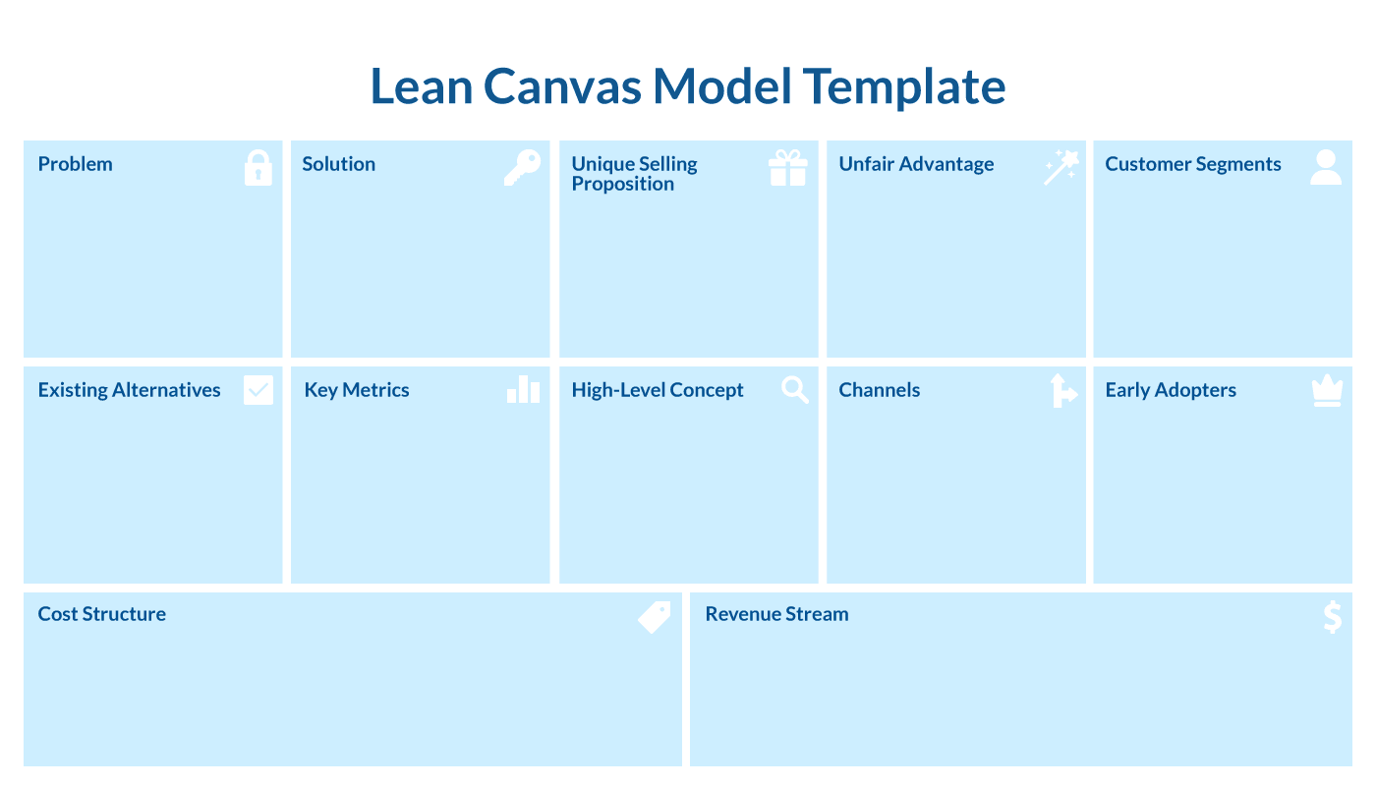

Slide 29
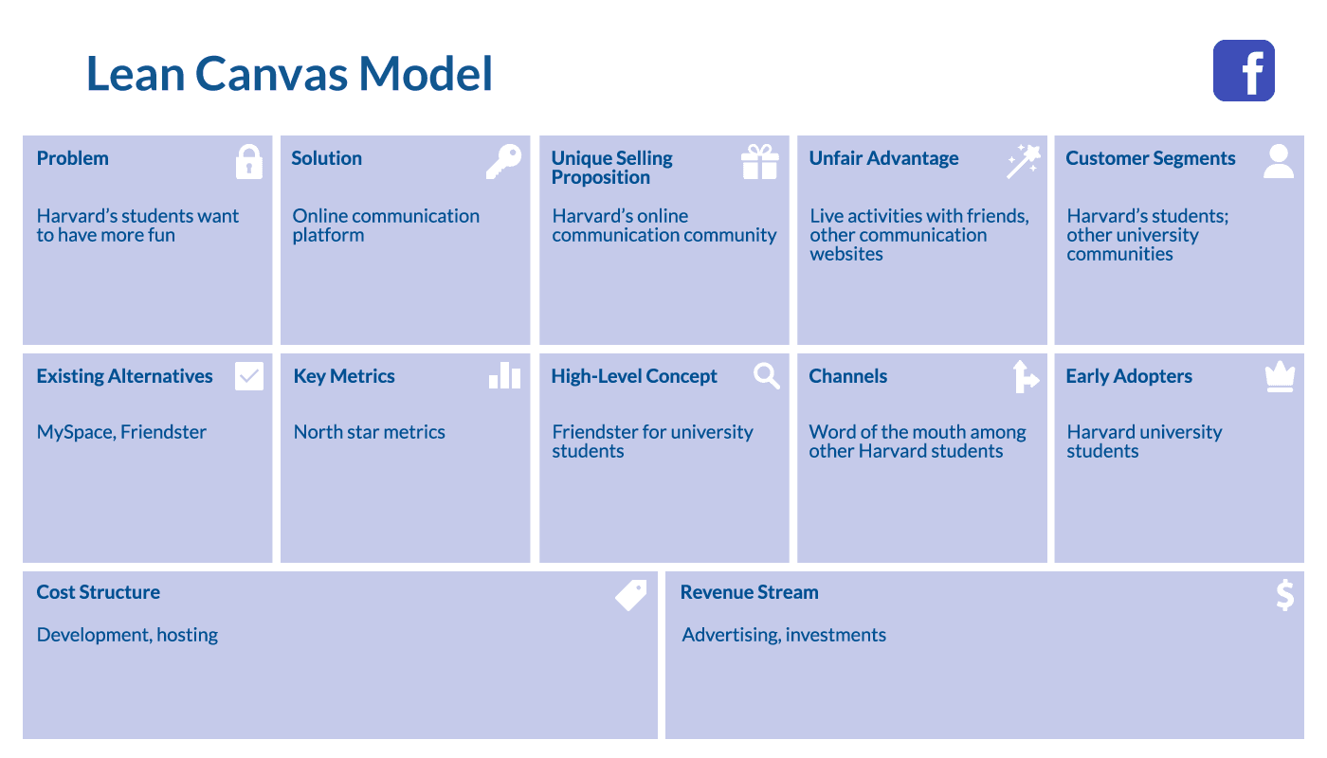
Do you know what business this is ?

Slide 30
Do you know what business this is ?

Slide 31
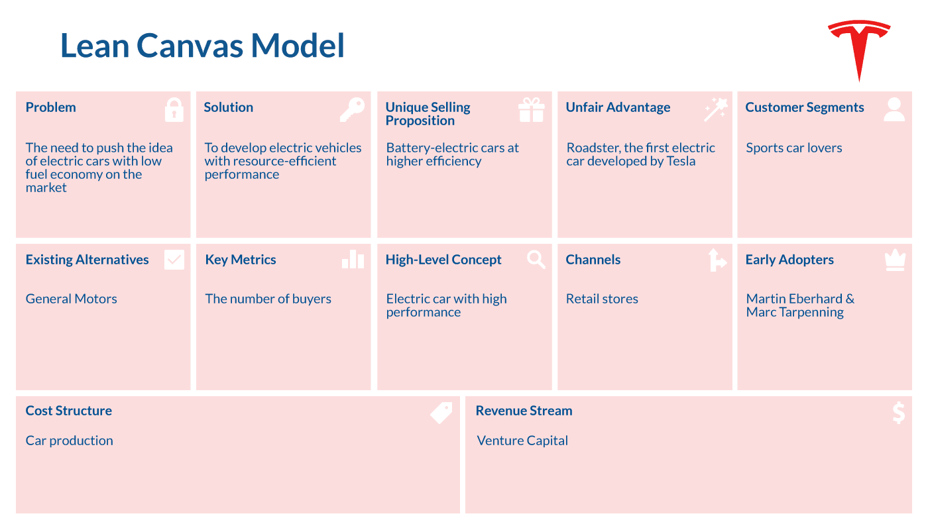
Do you know what business this is ?

Slide 32
Do you know what business this is ?

Slide 33




ECPCGC Training
Presales
Preparation for Client Meeting
Research
Skills & Knowledge
Module 1
Presales
Gather all the information you can, before meeting your customer
Valuable sources are (for example):
Online:
Personal:
Have you heared about the client before ?
Do you or could someone in your personal network / family know the person ?
Do you know someone who worked with that business before ?
Check your banking software, ask your colleagues about a possible
history with your institution
Remember! Every business is run by people!

Slide 34

Module 1
Presales
After we gathered the information necessary
→ Compile your existing information to get an idea of the customer and his/her business
Although important to make → Be careful with assumptions !
→ Identify missing parts in preparation to meeting your client
Presales

Slide 35

Module 1
Presales
Open your „Participants_Excel“ sheet you got with the invitation on the training
Open your Participants Tab „Information P1, P2, P3“on the bottom of the sheet
You will have 5 Minutes to note all the information you find useful about a client and what information you might need in a credit application
The information can be whatever you can think of (Personal, Financial, Business Model etc.)
Solo work:
Presales

Slide 36

Module 1
Presales
Presales
These are just topics and focused on business
So there is a lot….

Slide 37




Module 1
Presales
Skills & Knowledge in MSME Banking:
Presales
Knowledge about:
Guideline / Procedures / Manuals / Policies
Assessment of financial data
Assessment of qualitative information
Forecast assessment
What general and specific skills are helpfull when working in an MSME banking environment ?
General skills:
Time management
Conflict management
Communication skills
Specific skills:
Active listening
Detect client‘s needs
Note taking
Obeservation of information vs. Reality
When to address the correct question

Slide 38
Conclusion
Module 1
Presales
Presales

Slide 39
DSIK & ECPCGC
Virtual Training
Module 2
Client Meeting
XX.XX.XXXX

Slide 40
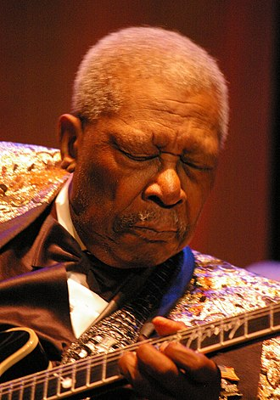
Module 2
Client Meeting
Quick repeat of Module 1
“The beautiful thing about learning is that nobody can take it away from you.”
B.B. King

Slide 41
Module 2
Client Meeting
  Information gathering
  Customer relationship management
  Interviewing methods
Client Meeting
General rules for Client Meetings:
Visit the business place whenever possible
The client should speak more than you in the meeting
Listen actively and participate
If the meeting focus drifts away, bring it back on track

Slide 42

Module 2
Client Meeting
So we know what we know and we identified what we want to know.
We get to information mostly through questions we ask the customer.
When we ask correctly we can
Gain an understanding for the clients needs
Check information
Avoid redundant information
Verify our assumptions
Create a detailed picture of the business

Slide 43
Types of questions
Open questions:
Open conversation
Build picture of business and customer
Don‘t target a specific answer
Verify specific areas of business
Examples:
Tell me about your business ?
How did you start it ?
How do you organize activities in your shop ?
What do you plan in the future ?
What is your advantage in the market ?
Invites the person responding to provide information into how they feel and what they think about a subject
              Far more detail !

Slide 44
Types of questions
Closed questions:
Have a defined answer yes/no
May be a figure
Is used to gather specific essential data
Follows an open question
Examples:
How much do you pay your workers ?
Is your shop rented ?
What are the shipping cost for one container ?
Who is your supplier ?
Do you have experience ?
If overused, closed questions will lead to an interrogation rather than exchange.
But they can be very useful to verrify data and information

Slide 45
Types of questions
Group example
Timo will be your customer
You have no information about his business or what he is doing beforehand
One participant starts asking Open questions
When by accident there is a closed question asked, it‘s the next participants turn
After 3 questions or after a closed question the current asking participant appoints the next participant form the group to ask

Slide 46
Types of questions
Group example
→ Solution

Slide 47




Types of questions
Group practise
3-4 People will be in a breakout room
1 will act as relationship manager, 1 as a client/customer and 1-2 observers
Client open the tab
Relationship manager open the tab
Oberservers open the tab
Please stay in your tab and read instructions
Estimate time – 5 minutes for preparation – 10 minutes interview – 10 minutes feedback from spectators

Slide 48
Module 2
Client Meeting
To give you some guidelines on important information / questions for you and your client to answer for risk assessment we provide some questions for general business and additional extended questions depending on type of business extracted from our MSME Bank processing tool
General:
The business’ strategy for success and any management challenges.
Market share in % of the company?
Most important competitors?
Highlights of the business/client’s successes and opportunities realized.
Was owner insolvent or bankrupt in the past?
Have dates been met, in particular submission of documents and information?
Did we get formal and complete accounts (Balance Sheet, P&L, Forecast) ?
Are the company’s financial assets being managed satisfactorily (Maintenance, Insurance coverage)?

Slide 49
Module 2
Client Meeting
To give you some guidelines on important information / questions for you and your client to answer for risk assessment we provide some questions for general business and additional extended questions depending on type of business extracted from our MSME Bank processing tool
Industry specific: Churches / Religious Organizations
The legal structure of the religious organization, its powers to borrow and to own and charge collateral should be ascertained.
Some religious bodies are registered locally as a body corporate and provide agents with the power to borrow and charge security. This would allow the Bank to lend to the registered body and take security in the normal way.
Others may not be legally incorporated but operating through an internal arrangement, where Trustees are appointed by the members to look after the Church’s affairs. In such cases any lendings must be made to the Trustees in their personal capacity and they will be responsible for repayment of the debt and providing security.
The basic lending requirements for assessing such applications will apply and the Bank will need to be satisfied that the proposed debt can be serviced based on the financial information provided.

Slide 50
Module 2
Client Meeting
To give you some guidelines on important information / questions for you and your client to answer for risk assessment we provide some questions for general business and additional extended questions depending on type of business extracted from our MSME Bank processing tool
Industry specific: Distribution
What products and services do you offer?
Do you require a licence to operate the business?
Do you require storage space for your products?
Who are your customers and where are they located?
How are your products delivered to your customers and how often?
How are your main competitors?
How many distribution outlets do you have?
How effective is your delivery model?
Are you aware of any alternative product offering by your competitors?
Is the revenue generated sufficient to cover all costs generated by the business?
What plans do you have in place to cover any unforeseen circumstances?

Slide 51
Module 2
Client Meeting
To give you some guidelines on important information / questions for you and your client to answer for risk assessment we provide some questions for general business and additional extended questions depending on type of business extracted from our MSME Bank processing tool
Industry specific: Farming / Agriculture
The fragility of the crop and susceptibility to natural disasters such as floods, hurricanes, drought etc.
Is there a secondary source of income?
Security being offered. If farm land, what is value if entire crop is destroyed?
Maximum LTV ratio if agricultural land is offered as security – 50%.
Is there a ready market for the produce and can the funds be assigned?

Slide 52
Module 2
Client Meeting
To give you some guidelines on important information / questions for you and your client to answer for risk assessment we provide some questions for general business and additional extended questions depending on type of business extracted from our MSME Bank processing tool
Industry specific: Manufacturing
What products do you manufacture?
Do you require a license to operate the business?
Where do you operate from and do you require storage for your products?
Do you have general liability insurance coverage and is it sufficient?
Who are your clients and where are they located?

Slide 53
Module 2
Client Meeting
To give you some guidelines on important information / questions for you and your client to answer for risk assessment we provide some questions for general business and additional extended questions depending on type of business extracted from our MSME Bank processing tool
Industry specific: Other services
What services/ Products do you offer?
Do you require a license / formal qualification to operate the business?
Who are your main competitors?
What do you do to differentiate your products/services from the competition?
Is the business seasonal? If yes, what plans do you have in place for the low season?
Do you maintain Liability Insurance, and is the coverage adequate?
Does the business generate sufficient revenue to cover all expenses and record a profit?
Do you have more than one outlet?
Are there any know barriers to selling your products/ Services?
Do you have business partners?

Slide 54
Module 2
Client Meeting
To give you some guidelines on important information / questions for you and your client to answer for risk assessment we provide some questions for general business and additional extended questions depending on type of business extracted from our MSME Bank processing tool
Industry specific: Real Estate/Property Investment/Land Development
Is the investment financially self-sustaining? Can income from the property/investment cover interest and principal payments on the loan, property taxes and other associated expenses.
Whether the customers have previous experience in owning and managing such investments?
Gros Rental Income must be netted by 50%.
Repayment must come from rental income which must be netted to accommodate:
I. Occupancy loss.
II. Maintenance costs.
III. Planned capital expenditures.
IV. Property taxes.
V. Management fees.
Appraisal/Valuation Reports must be prepared using the Income Capitalization Approach.
Absorption rate should also be included in the preparation of the Appraisal/Valuation reports. Absorption rate indicates the level of demand for apartments within the area, the speed at which apartments are being rented and what rent rate is appropriate.

Slide 55
Module 2
Client Meeting
To give you some guidelines on important information / questions for you and your client to answer for risk assessment we provide some questions for general business and additional extended questions depending on type of business extracted from our MSME Bank processing tool
Industry specific: Taxi
Level of income that can be earned, based on the number of vehicles on that particular route. Careful consideration should also be given to holidays and days off due to rotations etc. when calculating Income.
Is the income sufficient to meet regular maintenance, insurance, personal expenses and contingencies?
Will the bus be operated by the owner or third party?
Operator must be the owner of a valid license(endorsement) to operate a minibus?
Borrower must be the owner of a valid Route Permit or Peg?
An escrow account should be opened to meet annual insurance payments.

Slide 56
Module 2
Client Meeting
To give you some guidelines on important information / questions for you and your client to answer for risk assessment we provide some questions for general business and additional extended questions depending on type of business extracted from our MSME Bank processing tool
Industry specific: Transportation
What type of transportation services do you provide?
What route do you operate/ Ply?
Who operates the bus on the route?
Are you or the individual operating the bus, an authorized driver on the route with a valid route Band and proper endorsement as required?
How many trips do you make daily and who manages these trips?
What level of income can be earned based on the number of vehicles that operate from this route? Careful consideration must be given to holidays and days off due to rotation etc. when arriving at the income calculation.
Is the income earned sufficient to meet the regular maintenance? Insurance, personal expenses and contingencies?
Who are your main competitors on that route?
An escrow account should be opened to meet annual insurance payments and maintain a minimum debt reserve balance.

Slide 57
Conclusion
Module 2
Client Meeting
Customer
Journey
Presales
Client Meeting

Slide 58
Thank you.
Contact
ECCU Representative – Uwe Pfeffer
Uwe.Pfeffer@sparkassenstiftung.de
EECU Long Term Expert – Timo Bucher
Timo.Bucher@sparkassenstiftung.de

Slide 59
DSIK & ECPCGC
Virtual Training
Module 3
P&L and Balance Sheet
XX.XX.XXXX

Slide 60
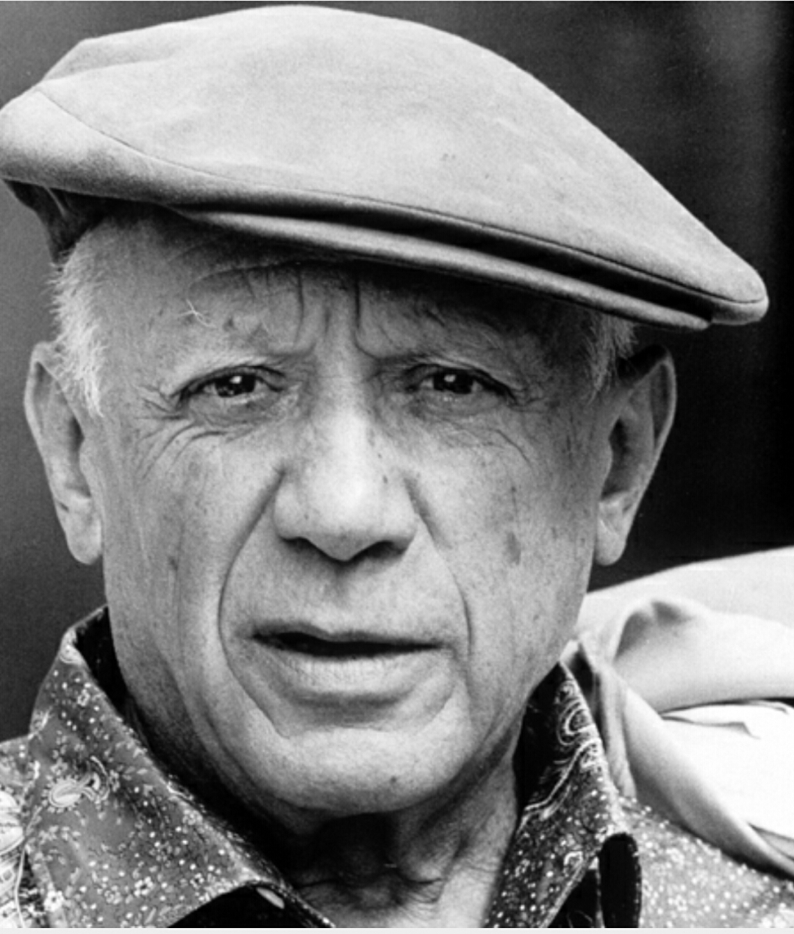
Module3
P&L and Balance Sheet
Quick repeat of Module 2
“I am always doing that which I cannot do, in order that I may learn how to do it.”
Pablo Picasso

Slide 61

Module3
P&L and Balance Sheet
  Understanding, calculating and interpreting selected financial metrics
  Cash-Flow analysis
P&L and Balance Sheet

Slide 62

Module3
P&L and Balance Sheet
P&L and Balance Sheet
After interviewing our client we know allready about his business model,
his planned investment and much more
We get further information from financial documents.
This brings a deeper understanding of the business as well as we lay the foundation for a well prepared credit assessment
What are the main financial documents for you to analyse a business ?

Slide 63



Module3
P&L and Balance Sheet
P&L and Balance Sheet
Main financial documents:
Balance Sheet → Describes where the enterprise stands at a specific date
Profil & Loss Statement → Shows the revenue and expenses for a designated time period
Cash-flow Statement → Shows the ways cash has changed during a designated time period
Supporting financial documents:
Tax returns
Aging Reports
Statement of equity / shareholders

Slide 64
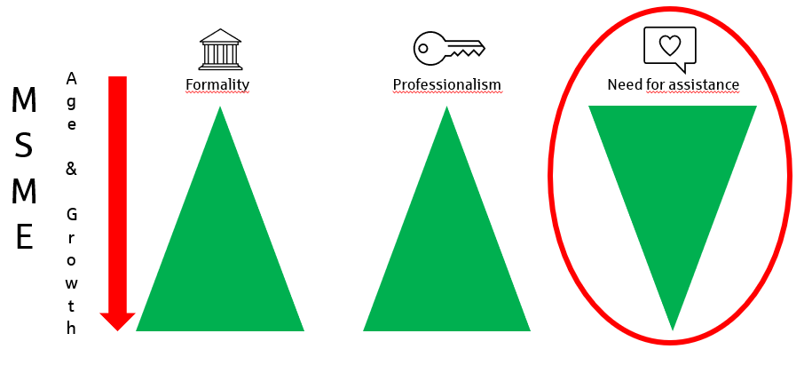
Module3
P&L and Balance Sheet
P&L and Balance Sheet
Not all financial documents are usually available is MSME business
Sometimes there are close to none
Remember ?

Slide 65


Story:
Jonathan wants to start his business. He is 19 years old. He has a drivers licence, likes to drive and is into cars.
So he thought about starting as a Taxi driver. He has some savings (XCD 5,000) from jobs he took during school and from some jobs in the last couple of years.
He worked as an employed Taxi driver before and thinks of starting his own business. For starting his business his uncle gifts him XCD 25,000. With the money he collected he bought his first asset. A used car for XCD 21,000.
Question:
What financial document can you create with the above information given ?
Jonathans Taxi
Balance Sheet Starting Day
Assets |  | Liabilities
Cash | 9,000 $ | Liabilities | 0,000 $
Used Car | 21,000 $ | Equity | 30,000 $
Total | 30,000 $ | Total | 30,000 $

Slide 66

Story:
Jonathan started the business. He usually drives 5 days a week. He has an average of 5 customers per day and an cash intake from clients of XCD 600 per day. He spends about XCD 5,000 a months for gas.
Task:
Do a short Profit & Loss statement for 1 month (20 workdays) with the above given information
Profit & Loss Jonathans Taxi Month January in XCD | Liabilities
Sales | 12,000
Cost of Sales | 5,000
Net Profit | 7,000
….
Solo work
Go to your Participants Excel in the tab „P&L PX“ to help Jonathan do his first Profit & Loss Statement after his first year of running his business.

Slide 67



Corporate crisis phases
Strategy crisis
Profit Crisis
Liquidity Crisis
Be close to your customer to detect early stages of crisis
The earlier you know about problems, the easier they are to solve
Notes:
Discussion

Slide 68
Cash-Flow analysis
Operational activity
Finance activity
Investing activity
+ Inflow / Intake
Cash at the beginning of period
Cash at the end of period
+ Outflow / Outtake
Expenses / Suppliers
Banks / Investors
Investment in Assets
And more ….

Slide 69
Cash-Flow analysis
Operational activity
Finance activity
Investing activity
+ Inflow / Intake
Cash at the beginning of period
Cash at the end of period
+ Outflow / Outtake
Expenses / Suppliers
Banks / Investors
Investment in Assets
And more ….

Slide 70
Operational Cash-Flow
Payments by clients – Cash / Credit Card / Wire transfer / Cheque…
+ Inflow / Intake
Cash at the beginning of period
Cash at the end of period
+ Outflow / Outtake
All Payments to
Suppliers
Workers
Rent
Insurance
Taxes
Marketing
Insurance
Interest
And more ….
Notes:
What about Depreciation ?

Slide 71
Cash-Flow analysis
Operational activity
Finance activity
Investing activity
+ Inflow / Intake
Cash at the beginning of period
Cash at the end of period
+ Outflow / Outtake
Expenses / Suppliers
Banks / Investors
Investment in Assets
And more ….

Slide 72
Financial Cash-Flow
Loan Disbursements
Issuing Equity or Stock which is sold to investors
+ Inflow / Intake
Cash at the beginning of period
Cash at the end of period
+ Outflow / Outtake
All Payments to
Loan Repayment
Dividends to Shareholders
Stock repuchases
Notes:
What about Overdraft Facility?

Slide 73
Cash-Flow analysis
Operational activity
Finance activity
Investing activity
+ Inflow / Intake
Cash at the beginning of period
Cash at the end of period
+ Outflow / Outtake
Expenses / Suppliers
Banks / Investors
Investment in Assets
And more ….

Slide 74
Investing Cash-Flow
Sales of fixed assets
Sales of Investments
+ Inflow / Intake
Cash at the beginning of period
Cash at the end of period
+ Outflow / Outtake
Purchase of fixed assets
Shares purchase of other companies
Notes:
What about Overdraft Facility?

Slide 75
Cash-Flow analysis
Discussion
Why do we calculate Cash-Flow and why do we keep track of it ?
To detemine if the liquidity or cash is sufficient to pay the expenses
To detect working capital needs as soon as possible – not just when the account is overdrafted
To detect seasonal demand
Make better plans and decisions
Understand where the money is coming from and when/where the client is spending his money
…
Side note: In your package is a „Source List“. There you can find additional information on the importance of cash-flow,
reasons for Cash-flow problems and how to fix them

Slide 76



Story:
Jonathan approaches you as his banker. He has been negotiating with a hotel as a potential client. They want him to transport their guests between the hotel and the airport. For that he needs to invest in a bus and comes to you for a loan request.
He has been gathering his financial documents and wrote down some notes related to this business growth opportunity. You two start working on his cash-flow predictions
Open your „Participants_Excel“ sheet you got with the invitation on the training
Open the Tab „Cash Flow P X“ on the bottom of the sheet
You will have XX Minutes to help Jonathan do his cash-flow planning for his upcoming year

Slide 77

1. Jonathans Taxi business is still expected to stay stable at an Income from customers of XCD 15,000 per month.
2. The new business opportunity is estimated to be making XCD 25,000 during the main season from November until (including) May and XCD 12,500 during off season. But the hotel pays Jonathan 1 month after he provided his service.
2. His insurance for the Taxi and the Bus is now XCD 10,000 for the whole year, paid in December.
4. He pays the employee who’s driving the Bus XCD 5,000 a month throughout the whole year. With a bonus of XCD 1,000 for Christmas.
5. He added up his "other expenses" to be at around XCD 500 a month.
6. The car insurance for the year is XCD 10,000
7. He has gas expenses of XCD 20,000 during the season and XCD 13,000 in off season which he pays without any payment target.
8. You quickly calculate a loan for him. The loan is XCD 50,000 and disbursed in January. His monthly repayment is XCD 1,000 (starting in February). Your bank charges XCD 120 monthly for Services.
9. Jonathan wants to rent a place for XCD 500 to have a place to keep the vehicles and do small repairs. The place he is looking at is available in March.
10. Jonathan expects to up his salary for his personal use from XCD 6,000 to XCD 10,000 from May in the year.
Notes:
Excel advise on multiplying answers

Slide 78
Balance Sheet analysis
Assets | Liabilities
Cash and equivalent | Loans
Receivables | Payables
Goods | …
Real Estate
… | Equity
Equity = Assets - Liabilities

Slide 79
Balance Sheet analysis
Timo‘s Company Ltd.
Assets |  | Liabilities
Cash | 25,000 $ | Liabilities | 65,000 $
Other Assets | 100,000 $ | Equity | 60,000 $
Total | 125,000 $ | Total | 125,000 $
Vela‘s Company Ltd.
Assets |  | Liabilities
Cash | 20,000 $ | Liabilities | 30,000 $
Other Assets | 105,000 $ | Equity | 95,000 $
Total | 125,000 $ | Total | 125,000 $
Which company seems better to you ? Explain your decision ?
→ Vela has more Equity → Timo has more cash

Slide 80
Balance Sheet analysis
Timo‘s Company Ltd.
Assets |  | Liabilities
Cash | 25,000 $ | Liabilities | 65,000 $
Other Assets | 100,000 $ | Equity | 60,000 $
Total | 125,000 $ | Total | 125,000 $
→ Still a solid company

Slide 81
Balance Sheet analysis
Things to keep in mind when analysing a balance sheet:
It just shows the frozen state at a specific point in the past
Does the documented information match the visible and verbal information the customer gave you ?
To evaluate ratios, figures and rates there are benchmarks necessary
Different industries have completly different balance ratios and relations

Slide 82
Financial analysis
Activity ratios
Liquidity Ratios
Solvency Ratios
Ratios show how well company uses its assets, especially working capital
Ratios show how well company is managing its liquidity
How well company can serve its liabilities
Profitability Ratios
Company capability to generate profit
Debt servicing ratios
Company ability to service existing obligations

Slide 83
Financial analysis
Most powerful financial figures and ratios
Equity Ratio: Calculated by dividing total Equity by total assets
Total Equity
Total Assets
Equity Ratio =
Example:
Assets |  | Liabilities
Cash | 20,000 $ | Liabilities | 60,000 $
Other Assets | 80,000 $ | Equity | 40,000 $
Total | 100,000 $ | Total | 100,000 $
Equity Ratio = 40 / 100 = 0.4 or 40%

Slide 84
Financial analysis
Most powerful financial figures and ratios
Equity Ratio: Calculated by dividing total Equity by total assets
Total Equity
Total Assets
Equity Ratio =
Use:
→ The Equity Ratio shows how much of a company‘s assets are funded by equity rather than borrowing money.
The ratio can be an indicator of how financially stable the company may be in the long run.

Slide 85
Financial analysis
Most powerful financial figures and ratios
Working Capital:
The difference between a company’s current assets and its current liabilities
Working Capital = current assets deducted by current liabilities
Use:
→Used for measuring the current liquidity situation and eventually identifying external financing needs

Slide 86
Financial analysis
Most powerful financial figures and ratios
Debt Service (Coverage) Ratio
The ratio between a companies operating income to cover it‘s debt obligations
EBITDA
Debt Service Ratio =
Interest + Principal
Example:
29,760
Debt Service Ratio =
5,175+ 12,600
= 1.7

Slide 87
Financial analysis
Most powerful financial figures and ratios
Debt Service (Coverage) Ratio
The ratio between a companies operating income to cover it‘s debt obligations
EBITDA
Debt Service Ratio =
Interest + Principal
Use:
→ Used for measuring the ability of a business to cover its debt servings. A high ratio suggests that the company is capable of taking on more debt.

Slide 88

Financial analysis
All financial figures, ratios and numbers have a meaning. But how to interpret them ?
Guess the business game
Go to your „participants excel“ in the tab
You will be moved into breakout-rooms
Discuss in your group what kind of businesses could match to the given financial information

Slide 89
Financial analysis
Last thoughts
We must be careful with financial analysis → „Strong past“ doesn‘t necessarily mean „strong future“
Every company has ups and downs, our job is to detect this as early as possible and act accordingly
Different business models have different financial needs, it‘s our job to find the right solutions in the given situations
→ Better solutions → Better customer relation → Stable and profitable relation
Collaterals are only a safety net – sustainability of our clients business models is what drives our customer value and profit → therefore cash-flow and the enterpreneur personality should drive our loan decisions

Slide 90
Module3
P&L and Balance Sheet
Conclusion of Module 3

Slide 91
Cash-Flow activity pattern
Operating
Activities
Investing
Activities
Financing
Activities
This company is building cash and is highly liquid
This company generates cash from operations and
is buying assets and paying debt and owners
This company is using cash from operations and selling
Assets to pay debt
This company uses cash from operations and from
Lending / Investment to expand

Slide 92
Cash-Flow activity pattern
Operating
Activities
Investing
Activities
Financing
Activities
This company covers cash flow problems by selling assets and
By lending / investment
This company is growing but has shortages from
operations and buying assets with debt
This company is trying to stay in business
by selling their assets to cover expenses
This company is burning through cash reserves to cover expenses
And pay creditors / investors

Slide 93
Thank you.
Contact
EECU Long Term Expert – Timo Bucher
Timo.Bucher@sparkassenstiftung.de

Slide 94
DSIK & ECPCGC
Virtual Training
Module 3
Assessment & Application
XX.XX.XXXX

Slide 95
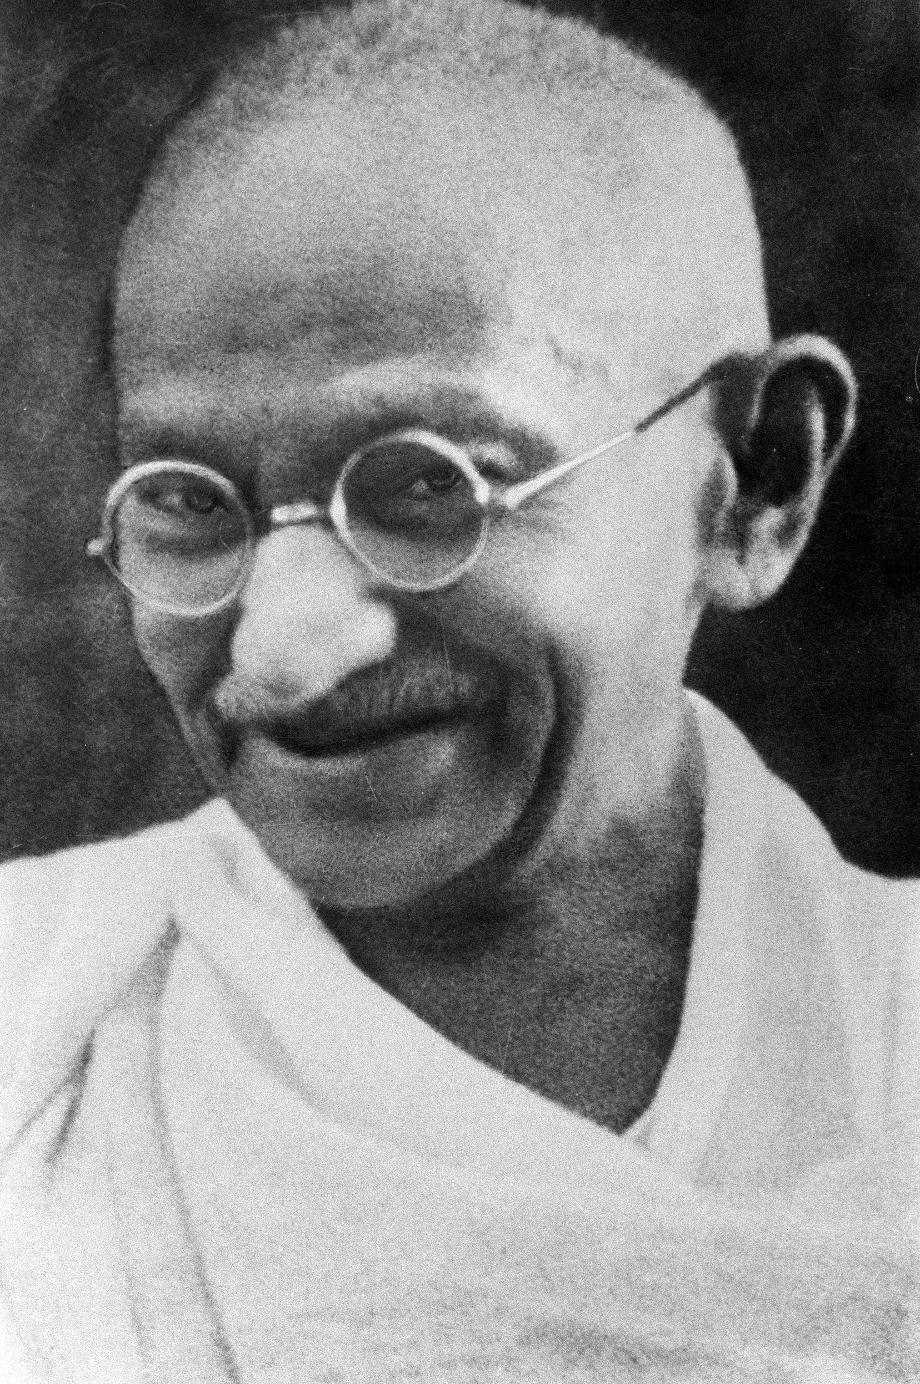
Module 4
Assessment & Application
Quick repeat of Module 3
“Live as if you were to die tomorrow. Learn as if you were to live forever.”
Mahatma Gandhi

Slide 96
Pricing
ECPCGC
Compiling and verifying data
Module 4
Assessment & Application
Assessment & Application
Now that we have gathered information in our client meeting through preparation and asking the right questions we start to compile the data together.

Slide 97
Module 4
Assessment & Application
Verifying and validating data / information
How do you do it ?
Compare the data with older data you have
Do the numbers match what you saw at the client visit ?
Look for inconsistencies / mismatches
Do research online or ask people who know the business / entrepreneur
Compare the ratios to similar businesses you know
…

Slide 98


Module 4
Assessment & Application
Throwback Module 2
Questions, data and risk
Group discussion:
3-4 People will be in a breakout room
Go to you participants_excel in the tab
You will be presented questions there
Discuss in your group which questions are influencing your loan decisions and weight them how important they are, discuss the answer with your group

Slide 99
Module 4
Assessment & Application
Throwback Module 2
Questions, data and risk
In this task there is no „right“ or „wrong“ !
But there is a way to structure these answers and utilize their capabilities to the maximum. After all, our work until now was focused around gathering information and interpret it.
So how to use it to it‘s maximum effect ?
The answer is a risk-adjusted Pricing

Slide 100
Module 4
Assessment & Application
Interest rate
What is interest ?
“Interest is the price you pay to borrow money”
Risk components
Profit components
How likely is the loan to default ?
How big will be my losses in case of default ?

Slide 101

Interest rate and risk-adjusted Pricing
Risk components
Is the management reliable ?
Is the market share of the company increasing ?
Succession planning in place ?
Is all financial information up to date ?
Is the repayment schedule in line with expected cash-flows ?
Is the business profitable ?
Are the financial projections realistic ?
Are all financial covenants being met ?
….
We interpret our gathered information about the customer and his business. Like a scale as you have just done in the group work.

Slide 102
Interest rate and risk-adjusted Pricing
Risk components
Dependand on the answers the „propability of default“ is rising or lowering. As soon as all questions and information is validated, answered and taken into consideration we can conlude a final „Rating“ for the customer.
→ How likely is the loan to default ?

Slide 103

Interest rate and risk-adjusted Pricing
Risk components
→ How big will be my losses in case of default ?
Collaterals are our insurance for the case a loan defaults
→ The fall-back scenario and not Plan A

Slide 104
Module 4
Assessment & Application
Interest rate and risk-adjusted Pricing
Risk components
How likely is the loan to default ?
→ We try to calculate the risk of the loan we are about to calculate
Our information we gathered is used to calculate a grade and therefore the “propability of default” or “PD” is utilized
How big will be my losses in case of default ?
We calculate the portion of the loan that is unsecured
We use collaterals to calculate the „loss given default“ or „LGD“. It takes the unsecured portion of loans into consideration

Slide 105
Module 4
Assessment & Application
Interest rate
Demo of Risk-Adjusted Pricing Tool

Slide 106
Module 4
Assessment & Application
Interest rate
In prior Modules we spoke about the importance of sustainable business models -> That is aswell factored within the „Rating“ System
A rating System can only be as good as the information that it is served.

Slide 107
Module 4
Assessment & Application
Quick Summary
Reliable data is key
Interest is the price for borrowing money. It is calculated by factoring in the probability of default and the impact of default as well as our profit components
We base our decision on business models first, collaterals are just a safety net / back-up plan

Slide 108
Module 4
Assessment & Application
Business Models
Easiest way to present a business model is the „Lean Canvas“
It factors in all the necessary components to a business model
It‘s multi beneficial. It helps the client to refine his business aswell as it makes it easy for us to understand the key factors of the business on one page
How can we utilize the Lean Canvas
for our client relationship management ?

Slide 109
Throwback Module 1:Lean Canvas
Lean Canvas is a way to explain a business model in 1 Page
There are variations of the Lean Canvas, such as the Business Model Canvas. The key idea stays the same
Problem
What are the 3 most important characteristics
of your issue?
Solution
3 important characteristics of your solution
Unique value proposition
Single, clear, compelling message that sates why you are different and worth paying attention.
Unique Selling Proposition
Differentiation to your competitors?
Customer Segments
List your target customers and target users
Key Metrics
… which you can measure and improve.
Channels
List your path to customers (inbound or outbound)
Cost Structure
List your fixed and variable coast.
Revenue streams
List your sources of revenue.

Slide 110
Lean Canvas
Problem
What are the 3 most important characteristics
of your issue?
Solution
3 important characteristics of your solution
Unique value proposition
Single, clear, compelling message that sates why you are different and worth paying attention.
Unique Selling Proposition
Differentiation to your competitors?
Customer Segments
List your target customers and target users
Key Metrics
… which you can measure and improve.
Channels
List your path to customers (inbound or outbound)
Cost Structure
List your fixed and variable coast.
Revenue streams
List your sources of revenue.
The 9 segments of the Lean Canvas is also a key part of our loan application and risk assessment.

Slide 111
MSME-
Lending
Lean Canvas
Questions
Rating
Risk-Adjusted Pricing
Financial
Analysis
Collaterals

Slide 112
MSME-
Lending
Lean Canvas
Questions
Rating
Risk-Adjusted Pricing
Financial
Analysis
Collaterals ?

Slide 113

Module 4
Assessment & Application
ECPCGC Guarantee
Group work
You will be separated into breakout rooms
Go to your Participants_Excel to the tab
Discuss in your group the advantages, the possibilities and the impact the Guarantee Programm will have on MSME lending
We will discuss the results afterwards in the group

Slide 114
Module 4
Assessment & Application
Conclusion

Slide 115
Thank you.
Contact
EECU Long Term Expert – Timo Bucher
Timo.Bucher@sparkassenstiftung.de

Slide 116
DSIK & ECPCGC
Virtual Training
Module 5
Approval & Disbursement
XX.XX.XXXX

Slide 117
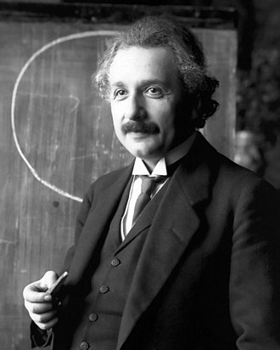
Module 5
P&L and Balance Sheet
Quick repeat of Module 4
“Intellectual growth should commence at birth and cease only at death.”
Albert Einstein

Slide 118

Module 5
Approval & Disbursement
Justify credit decision
Dealing with loan rejection
Recovery
Approval & Disbursement
What is Negotiation ?
Two or more parties try to find a mutual convenient solution

Slide 119

Module 5
Approval & Disbursement
Negotiation
Elements
Process
2 or more individuals
Communication
Different interests / objectives
Option of more than 1 outcome
Result is uncertain
Success = Acceptable outcome (for all parties)

Slide 120

Module 5
Approval & Disbursement
Negotiation Principles
People: separate people from the problem
Interest: concentrate on the interest not on position
Variations: Select options that are accepted by both parties
Criteria's: Insist on usage of objective criteria's

Slide 121
Module 5
Approval & Disbursement
Negotiation Hints for realtionship management
→ Arguing about positions will lead to illogical agreements
→ Once we get stuck in a position / problem, the solution can be to give it up and consider the other parties position
→ Arguing on positions will damage relationships
→ Consider the emotions of the client
→ Too much push on material interest will destroy relationship
→ Divide relationships from material interests

Slide 122
Module 5
Approval & Disbursement
Things to keep in mind while negotiating
Perception
Emotions
Communication
Reliable success and good deals

Slide 123
Module 5
Approval & Disbursement
Whatever we do, we negotiate…
„Let us never negotiate out of fear. But let us never fear to negotiate.“
John F. Kennedy
„If you are negotiating you must do so in a spirit of reconciliation,
not from the point of view of issuing ultimatums.“
Nelson Mandela
„Negotiation is not an act of battle; it‘s a process of discovery.
The goal is to uncover as much information as possible.“
Chris Voss (former Head Negotiator of the FBI)

Slide 124
Module 5
Approval & Disbursement
What happens when a loan application is not approved ?
Find out the reason behind it
When communicating → seperate the issue from the person
Show the client a way out
“Disapproval of a loan is a chance to improve your customer relationship and to lay an even stronger foundation for a successful relationship in the future”

Slide 125




Module 5
Approval & Disbursement
Group Exercise
You will be seperated into break-out rooms of 3-4 people
1 will act as relationship manager, 1 as a client/customer and 1-2 observers
Go to your participant_excel
Client open the tab
Relationship manager open the tab
Oberservers open the tab
5-10 Minutes for Preparation
10 Minutes roleplay
5-10 Minutes feedback

Slide 126
Module 5
Approval & Disbursement
Recap of the Group Exercise
Main goal was to not frustrate the client
The client understood the reason for the loan decline and both negotiators searched for a way to make the best of the situation
Ideally there was a compromise
For example: The client and the relationship manager stay in close contact for the next 6 months. The client tries his best to get signed agreements or Letters of Intent with potential buyers (to validate the revenue projection even more), maybe even from existing clients of the bank with a referral from the relationship manager
Relationship manager kept the door open for future collaboration

Slide 127
Module 5
Approval & Disbursement
Negotiation
Common Mistakes in negotiation
Letting emotions get in your way
Value is a personal thing. Everybody has his own perception of everything.
Solution:
Look at the situation from the outside, like a consultant instead of somebody that is emotionally involved
Assuming Win-Lose is the only option
Negtotiation do not need to end up in a win-lose situation, successful negotion on both sides isn‘t mutually exclusive
Solution:
Take the negotiation as a process to team up with the other person to find the best solution possible

Slide 128
Module 5
Approval & Disbursement
Negotiation
Common Mistakes in negotiation
Poor Ethics in Negotiation
No matter how strong the temptation, negotiators should never lie or deceive the other party
Solution:
Be honest and gain the confidence to be able to handle difficult negotiation scenarios
Not preparing adequately
Too often we rush into negotiations without proper planning.
Solution:
Before you start, make sure you understand not only your position, but also the other parties to develop a well-rounded understanding of the conversation you‘re about to have

Slide 129
Module 5
Approval & Disbursement
Negotiation
Common Mistakes in negotiation
Not communicating with the right people
There is no point in running a negotiation with people that don‘t have the authority to make a decision or a deal
Solution:
Keep in mind you are representing your organization, rather than your personal interests.

Slide 130
Module 5
Approval & Disbursement
Conclusion of Module 5

Slide 131
Thank you.
Contact
EECU Long Term Expert – Timo Bucher
Timo.Bucher@sparkassenstiftung.de

Slide 132
DSIK & ECPCGC
Virtual Training
Module 6
Aftersales
XX.XX.XXXX

Slide 133
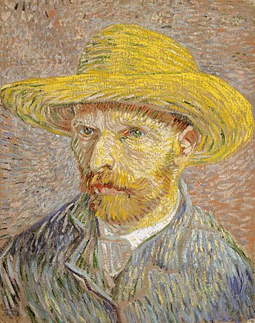
Module 6
Aftersales
Quick repeat of Module 5
“I am always doing what I cannot do yet, in order to learn how to do it.”
Vincent van Gogh

Slide 134

Module 6
Aftersales
Monitor loan usage
Financial monitoring
Referral business
Long term relationship building
Aftersales
What happens after Disbursement ?
What is your task as a relationship manager now ?

Slide 135
Module 6
Aftersales
Aftersales
1. After Disbursement we make sure the loan is used for what it‘s meant to be
→ Visit the business place for confirmation
→ Gather copies of invoices / Bill of Sale over
2. We profit from a stable customer relationship and the more stable the clients business is, the more stable is their loan repayment performance
  So we implement financial monitoring (when applicable)
3. We invested a lot of work into our client until the disbursement
→ So we look for more profit options now
(Cross-Selling / Referral business)

Slide 136
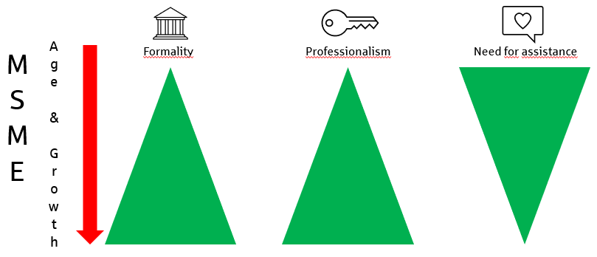
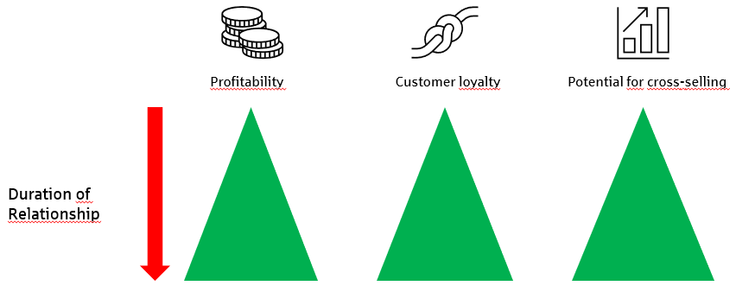
Aftersales
Customer:
Financial
Institution:

Slide 137
Module 6
Aftersales
Group Exercise
You will be seperated into break-out rooms of 3-4 people
Go to your participant_excel in the tab
Discuss in your group possibilities and ways to strenghten your customer relationship building.
15 minutes group discussion
Presentation of results afterwards

Slide 138
Module 6
Aftersales
Loan usage
We have assesed the loan application and disbursed for a specific plan from our client
→ We have to make sure that the funds are used accordingly
If needed we provide support from our network to our customer (distributors, craftsman, e.g.)
Gather the required bills of sale over or copy of invoices to provide confirmation of the usage of the loan
Don‘t disburse all funds at once. If applicable / possible do it in tranches

Slide 139


Module 6
Aftersales
Financial Monitoring
Our approach:
Cash-Flow objectives
Business Models
Successful Long term customer relationship
Throwback „Corporate crisis phases“ (Module 3)

Slide 140
Corporate crisis phases
Strategy crisis
Profit Crisis
Liquidity Crisis
Be close to your customer to detect early stages of crisis
The earlier you know about problems, the easier they are to solve
Notes:
Discussion

Slide 141

Module 6
Aftersales
Financial Monitoring
Implement a regular point of contact between you and your client
Your decision how intense and how often
Try to arrange a regular flow of financial figures from your customer
Adjust to the customer‘s „Key metrics“ used
Analyse the information and look for early stages of crisis or possible improvement / adjustments
→ Don‘t make the customer feel overwatched. Explain him the benefits of your support and they will value it

Slide 142
Module 6
Aftersales
Additional Business opportunities
We invested a lot of work into our customer and the loan application
Your customers value that !
Profit possibilities:
We want to create additional business
Cross-Selling to our existing customer
Remember: Every business has an owner and a private person behind it!
Referral business
No Marketing in the world can beat a satisfied customers recommendation!

Slide 143
Module 6
Aftersales
Conclusion of Module 6

Slide 144
Thank you.
Contact
EECU Long Term Expert – Timo Bucher
Timo.Bucher@sparkassenstiftung.de

Slide 145
DSIK & ECPCGC
Virtual Training XX.XX.XXXX

Slide 146
MSME Training
Customer Journey
Presales
Client Meeting
P&L and BS
Assessment & Application
Approval
& Disbursement
Aftersales
Outro

Slide 147
ECPCGC Training
Presales
Client Meeting
P&L and Balance Sheet
Preparation for Client Meeting
Research
Information gathering
Customer relationship management
Interviewing methods
Understanding, calculating and interpreting selected financial metrics
Cash-Flow analysis
Skills & Knowledge
Training-Content
Customer Journey as orientation for
Training modules

Slide 148
ECPCGC Training
Approval & Disbursement
Aftersales
Justify credit decision
Monitor loan usage
Assessment & Application
Pricing
ECPCGC
Compiling and verifying data
Financial monitoring
Referral business
Long term relationship building
Dealing with loan rejection
Recovery
Training-Content
Customer Journey as orientation for
Training modules

Slide 149
Importance of our support
MSME
Age & Growth
Formality
Professionalism
Need for assistance

Slide 150
Thank you.
Contact
EECU Long Term Expert – Timo Bucher
Timo.Bucher@sparkassenstiftung.de

