Slide 1
Workshop - Finance for Non-Finance Managers

Slide 2
Agenda
Introduction
2. Understanding Financial Statements
Financial Statement Analysis
Working Capital Management
Risk, Return and the Cost of Capital

Slide 3
Objectives
Understand basic financial reports
Utilise various accounting ratios to interpret the information contained in financial reports
Differentiate between options facing an organization and identify the one with the greatest return on investment
Utilise accounting tools and information to make better decisions for themselves and their organizations
Improve communication with accountants and bankers
Analyse Income Statements, Balance Sheets and Statements of Changes in Owners’ Equity and Cash Flow Statements

Slide 4
Schedule Day 1
09.00 - 09.30:
Introduction
09.30 - 10.15:
Unterstanding Financial Statements (1)
10.15- 10.30:
Break
10.30 - 12.30:
Unterstanding Financial Statements (2)
12.30 - 13.15:
Lunch Break
13.15 - 14.30:
Financial Statement Analysis (1)
14.30 - 14.45:
Break
14.45 - 16.15:
Financial Statement Analysis (2)
16.15 - 16.30:
Questions & Answers, Summary of the Day, Feedback

Slide 5
Schedule Day 2
09.00 - 09.30:
Questions & Answers, Revision of Day 1
09.30 - 10.15:
Working Capital Management (1)
10.15- 10.30:
Break
10.30 - 12.30:
Working Capital Management (2)
12.30 - 13.15:
Lunch Break
13.15 - 14.30:
Risk, Return and the Cost of Capital (1)
14.30 - 14.45:
Break
14.45 - 16.15:
Risk, Return and the Cost of Capital (2)
16.15 - 16.30:
Questions & Answers, Summary of the Day, Feedback

Slide 6
1
Introduction

Slide 7
Who we are
Joint institution of the Sparkassen-Finanzgruppe
Legal form: Non-profit organization (“eingetragener Verein”)
Foundation: January 8, 1992
Head office: Bonn, Germany

Slide 8
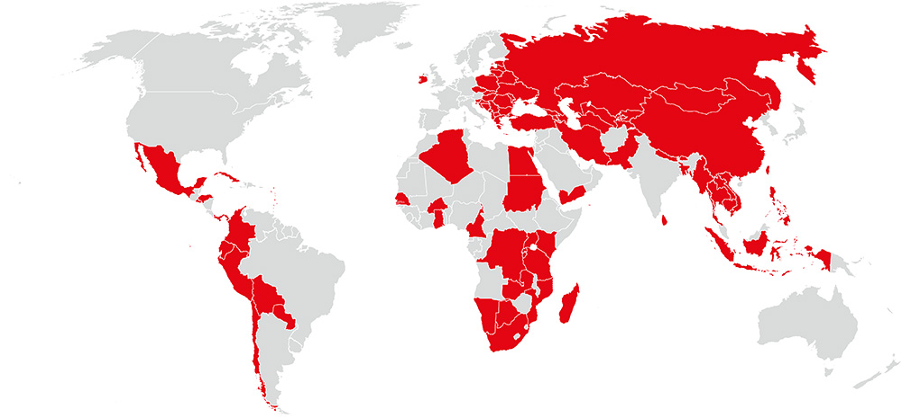
Projects world-wide
as of 30/06/2016
Since 1992: more than 200 projects in over 80 countries

Slide 9
Core competences
Retail Banking
HR Development and Training
Financial Sector Development
Financial Literacy and Savings Mobilisation
Microfinance
SME Finance

Slide 10
Pilot Project Saint Lucia
Support
Saint Lucia‘s SME Sector
Financial inclusion for small and medium-sized entreprises

Slide 11
Johannes Steger
EDUCATION:
Master of Science in Finance & Accounting
(Otto-Friedrich-University – Bamberg, Germany)
Bachelor of Arts, Dual studies bank-business administration
(Cooperative State University – Mosbach, Germany)
WORK EXPERIENCE AND TRAINING:
Savings Bank Bamberg, Credit Management
NORD/LB London branch, Structured Finance (Internship)
Savings Bank Foundation for International Cooperation (Junior Consultant)
Deloitte Munich, Financial Advisory – Valuation & Modeling (Internship)
Cooperative State University, Mosbach, Lecturer and advisor of scientific work
Savings Bank Bamberg, Corporate Customers Department
Savings Bank Bamberg, Dual student
PERSONAL INTERESTS:
Sports & Outdoor Activities
Family & Friends

Slide 12
Who are you? - Please introduce yourself
What are you doing?
What experiences with finance do you have?
What do you expect of this workshop?
Please write it down on a flipchart!
General remark:
In this workshop we want to invite you to work together.
Please feel free to ask and discuss!
Let‘s get the workshop interactive!

Slide 13
2
Understanding Financial Statements

Slide 14
Financial Statements?!
-
What comes into your mind?
Source: https://scrumcorp.de/2019/06/17/brainstorming-wie-man-es-anders-machen-kann/

Slide 15
Please build 3 groups …
Source: https://clipartstation.com/gruppenarbeit-clipart/

Slide 16
Please do research on your own on the following topics (30 min) and present it to the group afterwards (10 min each group) …
Balance Sheet (Group 1)
Income Statement (Group 2)
Cash Flow Statement (Group 3)
Source: https://enil.eu/news/introducing-enils-independent-living-research-network/

Slide 17
… in the following you can find a short summary of the results …

Slide 18
Source: https://www.investopedia.com/terms/b/balancesheet.asp

Slide 19
Why is it important?
A balance sheet is a financial statement that reports a company's assets, liabilities and shareholders' equity.
The balance sheet is one of the three (income statement and statement of cash flows being the other two) core financial statements used to evaluate a business.
The balance sheet is a snapshot, representing the state of a company's finances (what it owns and owes) as of the date of publication.
Fundamental analysts use balance sheets, in conjunction with other financial statements, to calculate financial ratios.
Source: https://www.investopedia.com/terms/b/balancesheet.asp

Slide 20
Source: https://www.investopedia.com/terms/i/incomestatement.asp

Slide 21
Why is it important?
An income statement is one of the three (along with balance sheet and statement of cash flows) major financial statements that reports a company's financial performance over a specific accounting period.
Net Income = (Total Revenue + Gains) – (Total Expenses + Losses)
Total revenue is the sum of both operating and non-operating revenues.
Revenues are not receipts. Revenue is earned and reported on the income statement. Receipts (cash received or paid out) are not.
An income statement provides valuable insights into a company’s operations, the efficiency of its management, under-performing sectors and its performance relative to industry peers.
Source: https://www.investopedia.com/terms/i/incomestatement.asp

Slide 22
Source: https://www.wikiaccounting.com/what-is-a-cash-flow-statement/

Slide 23
Why is it important?
A cash flow statement provides data regarding all cash inflows a company receives from its ongoing operations and external investment sources.
The cash flow statement includes cash made by the business through operations, investment, and financing—the sum of which is called net cash flow.
The first section of the cash flow statement is cash flow from operations, which includes transactions from all operational business activities.
Cash flow from investment is the second section of the cash flow statement, and is the result of investment gains and losses.
Cash flow from financing is the final section, which provides an overview of cash used from debt and equity.
Source: https://www.investopedia.com/terms/c/cashflowstatement.asp

Slide 24
How are the statements linked?
If you take a loan from the bank - how and where does it reflect here?
What about a machine financed 50% by the bank and 50% by yourself?

Slide 25
Case Study
… please build 3 new groups …
… and please discuss the figures you are handed out!
Which company would you like to work in or finance as a bank?
Which company is the best? Why?
Please present it to the group!
Source: https://essayscouncil.net/tips-writing-case-study/

Slide 26
Instruction: Company A

Slide 27
Instruction: Company B

Slide 28
… let‘s compare the results …

Slide 29
Solution
Company B has more equity than Company A.
Company B makes a profit. Company A makes a loss.
Company B‘s cash increased. Company A‘s cash decreased.
… going one step further:
=> Company B is better.
 | Company A | Company B
Equity Ratio | 20% | 80%
COGS Ratio | 60% | 40%
Personnel Expenses Ratio | 25% | 15%
Net Profit Ratio | - 15% | + 15%
Change in Cash | - $150.000,00 | + $50.000,00

Slide 30
Calculation of ratios
Equity ratio = $\frac{Equity}{Balance Sheet Total}$
COGS ratio = $\frac{COGS}{Total revenue}$
Personal expenses ratio = $\frac{Personal expenses}{Total revenue}$
Net profit ratio = $\frac{Net profit}{Total revenue}$

Slide 31
Where could you find further information on these topics?
Balance Sheet:
https://www.investopedia.com/terms/b/balancesheet.asp
https://www.youtube.com/watch?v=NkbCHQKxXXY
Income Statament:
https://www.investopedia.com/terms/i/incomestatement.asp
https://www.youtube.com/watch?v=HrBMenizbL8
Cash Flow Statement:
https://www.investopedia.com/terms/c/cashflowstatement.asp
https://www.youtube.com/watch?v=mZBjsIYrLvM

Slide 32
3
Financial Statements Analysis

Slide 33
Analysing Financial Statements?!
-
What comes into your mind?
Source: https://scrumcorp.de/2019/06/17/brainstorming-wie-man-es-anders-machen-kann/

Slide 34
In this chapter we are dealing with Key Performance Indicators (KPIs) in order to analyze Financial Statements…
… KPIs …
… measure a company's success versus a set of targets, objectives, or industry peers.
… can be financial, including net profit (or the bottom line, gross profit margin), revenues minus certain expenses, or the current ratio (liquidity and cash availability).
… can also be more general information, measuring foot traffic in a store, employee retention, repeat customers, and quality of customer experience, among others.

Slide 35
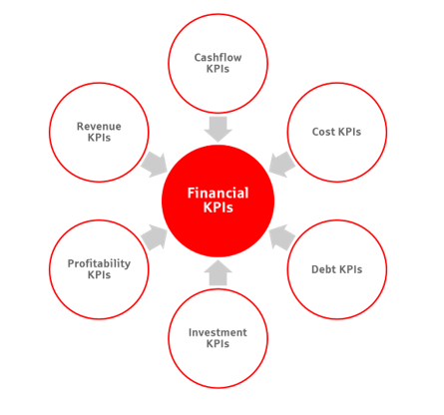
Financial KPIs can be divided into different categories…

Slide 36
Let‘s give an example: Cash Flow
Calculation:

Slide 38
Please build 3 groups …
Source: https://clipartstation.com/gruppenarbeit-clipart/

Slide 39
Please do research on your own on the following KPIs (30 min) and present it to the group afterwards (10 min each group) …
Tasks:
State the ratio
Why is it important to a company and to a bank?
How could a company improve the ratio?
Group 1
Costs of goods sold
Customer acquisition cost
Current Ratio
Group 2
Quick Ratio
Return on assets
Gross profit
Group 3
Sales volume
EBITDA
Break-even time
Source: https://enil.eu/news/introducing-enils-independent-living-research-network/

Slide 40
… let‘s compare the results …

Slide 41
Costs of goods sold
Calculation:

Slide 43
Customer acquisition cost
Calculation:

Slide 45
Current ratio
Calculation:

Slide 47
Quick ratio
Calculation:

Slide 49
Return on assets
Calculation:

Slide 51
Gross profit
Calculation:

Slide 53
Sales volume

Slide 55
EBITDA
Calculation:
EBITDA = Earnings before Interest, Tax, Depreciation and Amortization

Slide 57
Break-even time

Slide 59
Where could you find further information on these topics?
https://www.investopedia.com/terms/k/kpi.asp
https://www.youtube.com/watch?v=JN_EZU_Iyrg

Slide 60
4
Working Capital Management

Slide 61
Working Capital Management?!
-
What comes into your mind?
Source: https://scrumcorp.de/2019/06/17/brainstorming-wie-man-es-anders-machen-kann/

Slide 62
Balance Sheet: Operating and cash cycle accounts
Accounts Receivable
$ 700
Inventory
$ 300
Accounts Payable
$ 400
Working Capital = $ 600
Source: https://malaga-aas.com/en/2019/05/29/the-growth-option-during-financial-restructurings-the-working-capital-trap-2/

Slide 63
Please build 3 groups …
Source: https://clipartstation.com/gruppenarbeit-clipart/

Slide 64
Please do research on your own on the following ratios (30 min) and present it to the group afterwards (10 min each group) …
Tasks:
State the ratio
Why is it important?
How could a company improve the ratio?
Payable Days (Group 1)
Inventory Days (Group 2)
Receivable Days (Group 3)
Source: https://enil.eu/news/introducing-enils-independent-living-research-network/

Slide 65
Payable Days
Payable Days = $\frac{Payables}{Costs of sales}$ * 365
Why is it important?
It is a financial ratio that indicates the average time (in days) that a company takes to pay its bills and invoices.
Companies having a high ratio can use the available cash for short-term investments and to increase their working capital and free cash flow.
Calculation:
Source: https://www.investopedia.com/terms/d/dpo.asp

Slide 66
How can a company improve the ratio?
Outsourcing the payment processing makes it easy to stay on track and avoid late payment fees and disgruntled contractors from calling.
Many new businesses aren‘t prepared for seasonal sales fluctuations. So it is useful to keep adequate cash reserves to pay creditors after sales decline.

Slide 67
Inventory Days
Inventory Days = $\frac{Stock of goods}{Cost of sales}$ * 365
Why is it important?
It is the average number of days it takes for a firm to sell off inventory
It is a metric that banks are using to determine the efficieny of sales
A high ratio can indicate that a firm is not properly managing its inventory or that it has inventory that is difficult to sell
Calculation:
Source: https://www.investopedia.com/terms/d/days-sales-inventory-dsi.asp

Slide 68
How can a company improve the ratio?
Optimise the suplly chain by buying smaller quantities more frequently.
Encourage clients to pre-order inventory, because this assists the business in planning inventory purchases, moves inventory through the business fast, and enhances cash-flow.
Review and eliminate stagnant inventory to avoid it simply detoriating or occupying valuable warehouse space.

Slide 69
Receivable Days
Receivable Days = $\frac{Receivables}{Sales }$ * 365
Why is it important?
It is a measure of the average number of days that it takes a company to collect payment after a sale has been made.
It indicates the number of sales a company has made during a specific time period; how quickly customers are paying; if the company‘s collections department is working well; if the company is maintaining customer satisfaction, or if credit is being given to customers that are not creditworthy.
Calculation:
Source: https://www.investopedia.com/terms/d/dso.asp

Slide 70
How can a company improve the ratio?
Be prepared to enact debt collection or legal recourse activities. Don‘t wait until your client has disappeared and there‘s no chance of getting paid.
Set payment terms and/or offer discounts for early payments to motivate your clients to pay fast.

Slide 71
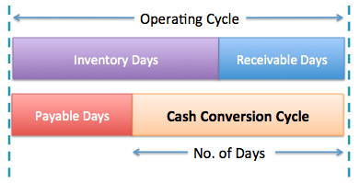
… combining the ratios leads us to Cash Conversion Cycle:
Cash Conversion Cycle
=
Inventory Days + Receivable Days – Payable Days

Slide 72
Case Study:
You are given the following numbers (see next slide) to evaluate Working Capital Management.
Please calculate…
Payable Days
Inventory Days
Receivable Days
What do you think about the numbers?
Is it good ar bad?
Why?
Source: https://essayscouncil.net/tips-writing-case-study/

Slide 73
Given data:
Sales: $ 350,000
Cost of sales: $ 200,000
Stock of goods: $ 160,000
Receivables: $ 300,000
Payables: $ 40,000
Source: https://essayscouncil.net/tips-writing-case-study/

Slide 74
Solution:
Inventory Days= | 160,000 | / | 200,000 | * | 365 | = | 292
Receivable Days= | 300,000 | / | 350,000 | * | 365 | = | 313
Payable Days= | 40,000 | / | 200,000 | * | 365 | = | 73
CCC = 292 + 313 – 73 = 532
Therefore, it takes the Company approximately 532 days to turn its initial cash investment in inventory back into cash.
Source: https://essayscouncil.net/tips-writing-case-study/

Slide 75
Please build 3 groups …
Source: https://clipartstation.com/gruppenarbeit-clipart/

Slide 76
Task:
Please think about how to improve one of each figure (10 min) and present the ideas afterwards (5 min)…
Payable Days (Group 1)
Inventory Days (Group 2)
Receivable Days (Group 3)
Source: https://essayscouncil.net/tips-writing-case-study/

Slide 77
Role Play:
Please choose two volunteers – 1 business owner, 1 loan officer!
Situation:
The business owner has a bad working capital management (as in our example).
The bank who is financing the business is critical because of that.
The business owner should explain possibilities towards the loan officer how to improve the working capital management.
Source: https://www.pinterest.com/pin/278519558177892101/

Slide 78
Where could you find further information on these topics?
https://www.investopedia.com/terms/w/workingcapitalmanagement.asp
https://www.youtube.com/watch?v=bHK77lbdyWA

Slide 79
5
Risk, Return and the Cost of Capital

Slide 80
Risk, Return and the Cost of Capital?!
-
What comes into your mind?
Source: https://scrumcorp.de/2019/06/17/brainstorming-wie-man-es-anders-machen-kann/

Slide 81
Thinking about risk and return …
Source: https://www.estas.de/Hochseilakt-in-den-USA

Slide 82
Source: https://bnn.de/nachrichten/wildline-in-bad-wildbad-nervenkitzel-am-sommerberg

Slide 83
Source: https://www.onvista.de/aktien/Apple-Aktie-US0378331005

Slide 84
Source: https://www.onvista.de/aktien/TUI-Aktie-DE000TUAG000

Slide 85
Source: https://www.dreamstime.com/relationship-risk-return-investitions-image166786167

Slide 86
Source: https://blog.wealthfront.com/risk-return/

Slide 87
Source: https://www.sdattonline.org/single-post/2018/10/12/The-Risk-and-Return-Relationship

Slide 88
Source: http://www.co.bosque.tx.us/page/bosqueauditor.rating

Slide 89
Risk management of a company: Risk Map
Source: www.visual-manager.ch/wp-content/uploads/trad_risk_map.png

Slide 90
Please build 3 groups …
Source: https://clipartstation.com/gruppenarbeit-clipart/

Slide 91
… think of different risks that occur in your business model!
Please present them on a flip chart and cluster them according to the risk map!
Source: wellspringconsultancy.com/product/risk-assessment-and-management-in-care-level-3-e-learning-cpd/

Slide 92
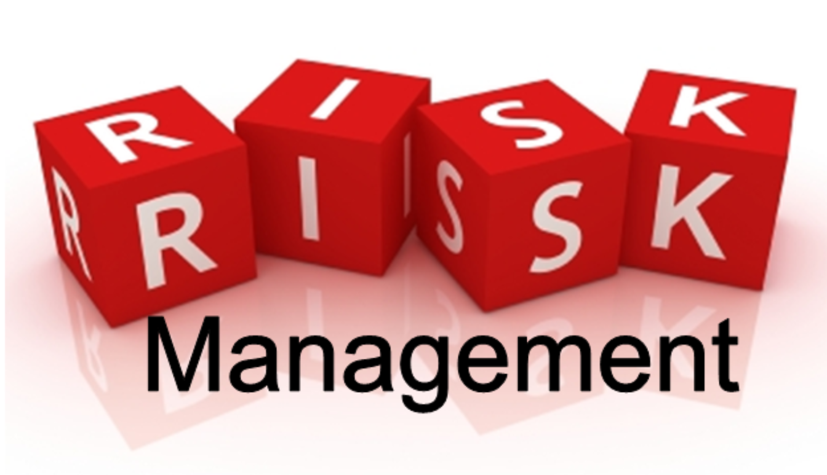
… please think of different measures that can be taken to manage the risks of your businesses and present them to the board!
… for example:
Avoid
Reduce
Diversify
Make Provisions
Insure
Accept
Source: https://www.rm4hd.com/risk-management-standards-and-risk-a-german-perspective
/

Slide 93
Where could you find further information on these topics?
https://www.investopedia.com/terms/c/costofcapital.asp
https://www.youtube.com/watch?v=mVbvPUUUgbY
https://www.youtube.com/watch?v=8DDn3pOcO1E
https://www.youtube.com/results?search_query=economic+return

Slide 94
Final Scores (1)

Slide 95
Final Scores (2)

Slide 96
Thank you!
Contact
e-Mail:
uwe.pfeffer@sparkassenstiftung.de
vela.samuel-frederick@sparkassenstiftung.de
johannes.steger@skba.de

